Slide 1
Probability and Stochastic Processes 2 Session 07 & 08
Course : COMP6577 – Machine Learning
Effective Period : February 2020

Slide 2
Learning Outcome
LO2: Student be able to interpret the distribution of dataset using regression method

Slide 3
Outline
Distribution example of discrete variables
The Bernoulli distribution
The Binomial distribution
The Multinomial distribution
Distribution example of continuous variables
The uniform distribution
The Gaussian distribution
The exponential distribution
The beta distribution
The gamma distribution
Case Study

Slide 4



The Bernoulli distribution
A random variable is said to be distributed according to a Bernoulli distribution if it is binary, X = {0, 1}, with
P(x = 1) = p, P(x = 0) = 1 − p
In a more compact way, we write x ∼ Bern(x|p) where
Its mean value is equal to
and its variance is equal to

Slide 5
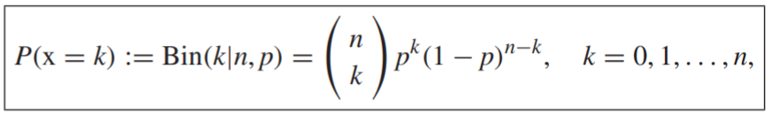
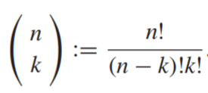
The Binomial distribution
A random variable, x, is said to follow a binomial distribution with parameters n, p, and we write x ∼ Bin(x|n, p) if X = {0, 1, ... , n} and
where by definition

Slide 6


The Binomial distribution (2)
For example, this distribution models the times that heads occurs in n successive trials, where P(Heads) = p. The binomial is a generalization of the Bernoulli distribution, which results if in previous Eq. P (x=k) we set n = 1. The mean and variance of the binomial distribution are
and

Slide 7
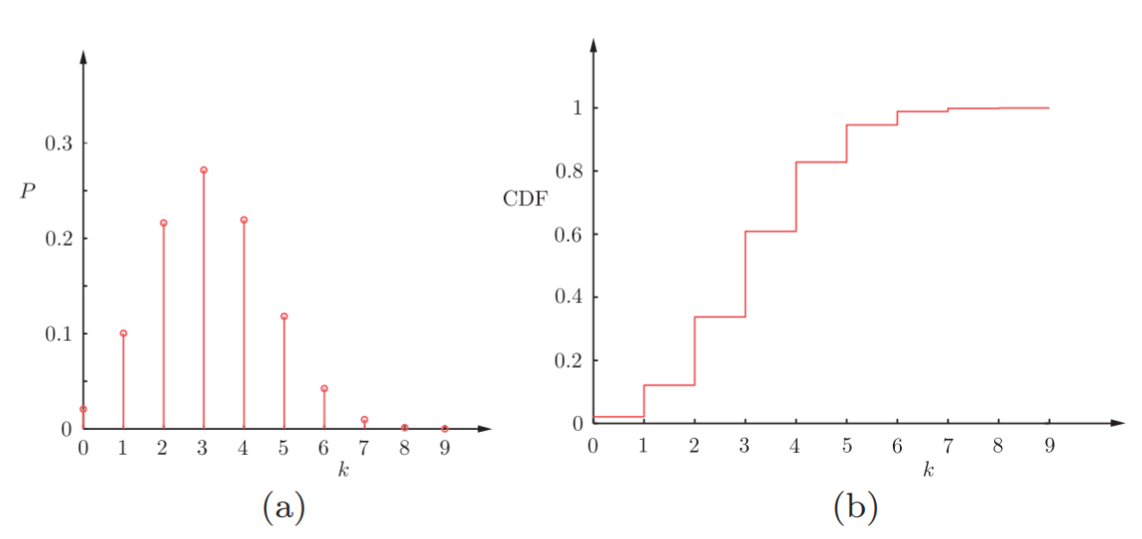
The Binomial distribution (3)
The figure (a) shows The probability mass function (pmf) for the binomial distribution for p = 0.4 and n = 9, while in figure (b) shows the respective cumulative probability distribution (cdf).
Observe that the latter has a staircase form, as is always the case for discrete variables.

Slide 8
The Multinomial distribution
This is a generalization of the binomial distribution if the outcome of each experiment is not binary but can take one out of K possible values.
For example, instead of tossing a coin, a die with K sides is thrown. Each one of the possible K outcomes has probability P₁, P₂, ... , P_{K}, respectively, to occur, and we denote P = [P₁, P₂, ... , P_{K}]^{T}
After n experiments, assume that x₁, x₂, ... , x_{K} times sides x = 1, x = 2, ... , x = K occurred, respectively. We say that the random (discrete) vector, x = [x₁, x₂, ... , x_{K} ]^{T}

Slide 9
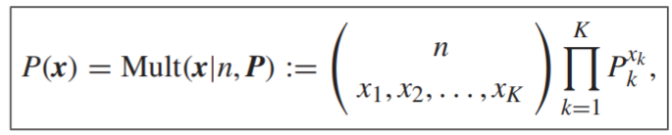
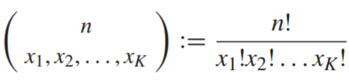
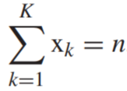
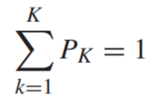
The Multinomial distribution (2)
follows a multinomial distribution, x ∼ Mult(x|n, P), if
Where
Note that the variables, x₁, ... , x_{K} , are subject to the constraint
and also
The mean value, the variances, and the covariances are given by

Slide 10
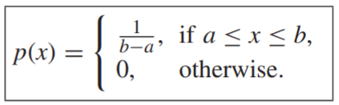
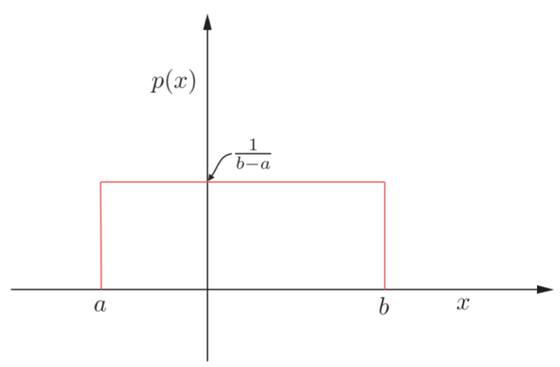
The uniform distribution
A random variable x is said to follow a uniform distribution in an interval [a, b], and we write x ∼ U(a, b), with a > −∞ and b < +∞, if:
The pdf of a uniform distribution U(a, b)

Slide 11


The uniform distribution (2)
The mean value is equal to
and the variance is given by

Slide 12
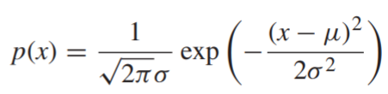

The Gaussian distribution
The Gaussian or normal distribution is one among the most widely used distributions in all scientific disciplines.
A random variable, x, is Gaussian or normal with parameters μ and σ², and we write x ∼ N (μ, σ²) or N (x|μ, σ²), if:
It can be shown that the corresponding mean and variance are:

Slide 13
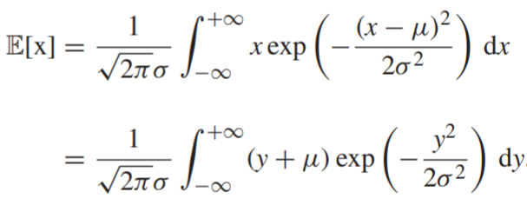
The Gaussian distribution (2)
Indeed, by the definition of the mean value, we have that
Due to the symmetry of the exponential function, performing the integration involving y gives zero and the only surviving term is due to μ. Taking into account that a pdf integrates to one, we obtain the result.

Slide 14
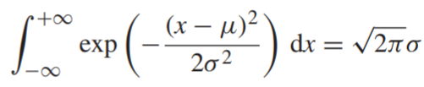

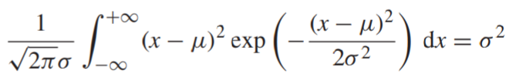
The Gaussian distribution (3)
To derive the variance, from the definition of the Gaussian pdf, we have that
Taking the derivative of both sides with respect to σ, we obtain
Or
which proves the claim.

Slide 15
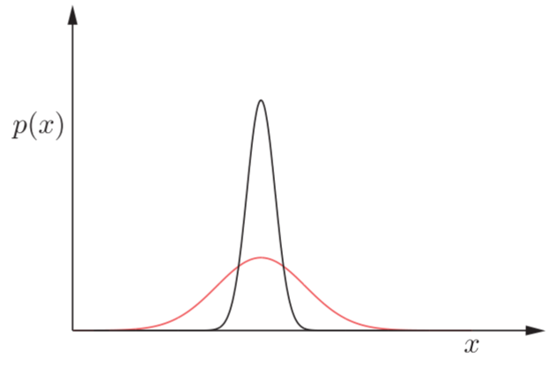
The Gaussian distribution (4)
The figure below shows the graph for two cases, N (x|1, 0.1) and N (x|1, 0.01). Both curves are symmetrically placed around the mean value μ = 1. Observe that the smaller the variance is, the sharper around the mean value the pdf becomes.

Slide 16
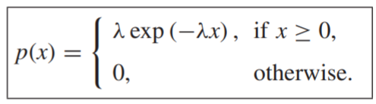

The exponential distribution
A random variable follows an exponential distribution with parameter λ > 0, if:
The distribution has been used, for example, to model the time between arrivals of telephone calls or of a bus at a bus stop. The mean and variance can be easily computed by following simple integration rules, and they are

Slide 17
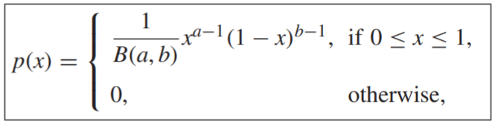
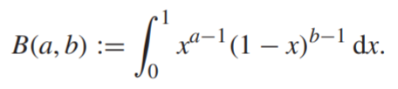
The beta distribution
A random variable, x ∈ [0, 1], follows a beta distribution with positive parameters, a, b, and we write, x ∼ Beta(x|a, b,), if:
where B(a, b) is the beta function, defined as

Slide 18




The beta distribution (2)
The mean and variance of the beta distribution are given by
Moreover, it can be shown
where is the gamma functions defined as

Slide 19
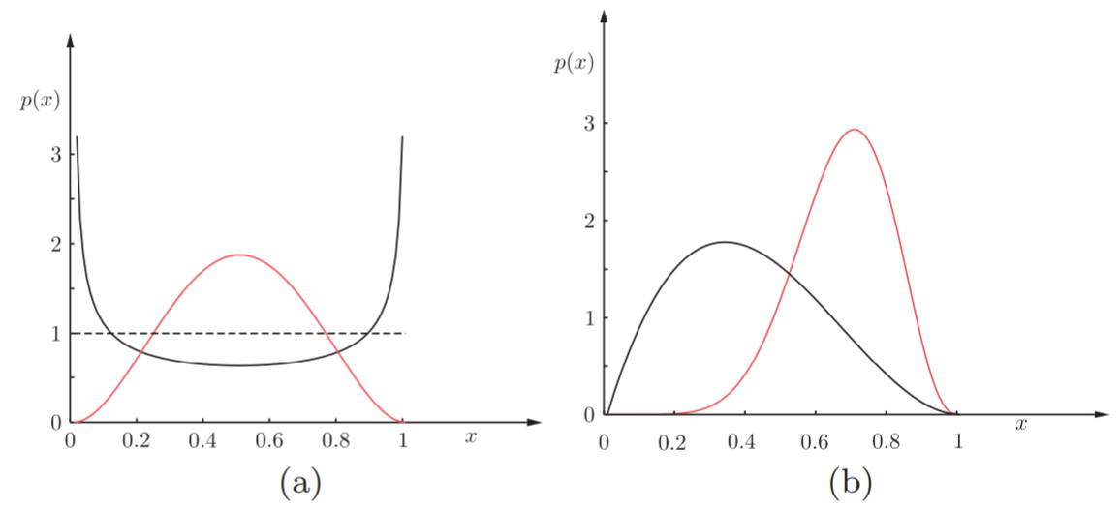
The beta distribution (3)
The beta distribution is very flexible and one can achieve various shapes by changing the parameters a, b. For example, if a = b = 1, the uniform distribution results. If a = b, the pdf has a symmetric graph around 1/2. If a > 1, b > 1 then p(x)→0 both at x = 0 and x = 1. If a < 1 and b < 1, it is convex with a unique minimum. If a < 1, it tends to ∞ as x→0, and if b < 1, it tends to ∞ for x→1.
Figures (a) and (b) show the graph of the beta distribution for different values of the parameters.

Slide 20
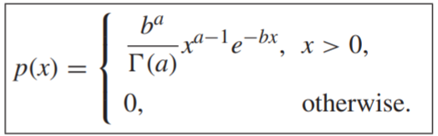

The gamma distribution
A random variable follows the gamma distribution with positive parameters a, b, and we write x ∼ Gamma(x|a, b) if:
The mean and variance are given by
The gamma distribution also takes various shapes by varying the parameters. For a < 1, it is strictly decreasing and p(x)→∞ as x→0 and p(x)→0 as x→∞.

Slide 21
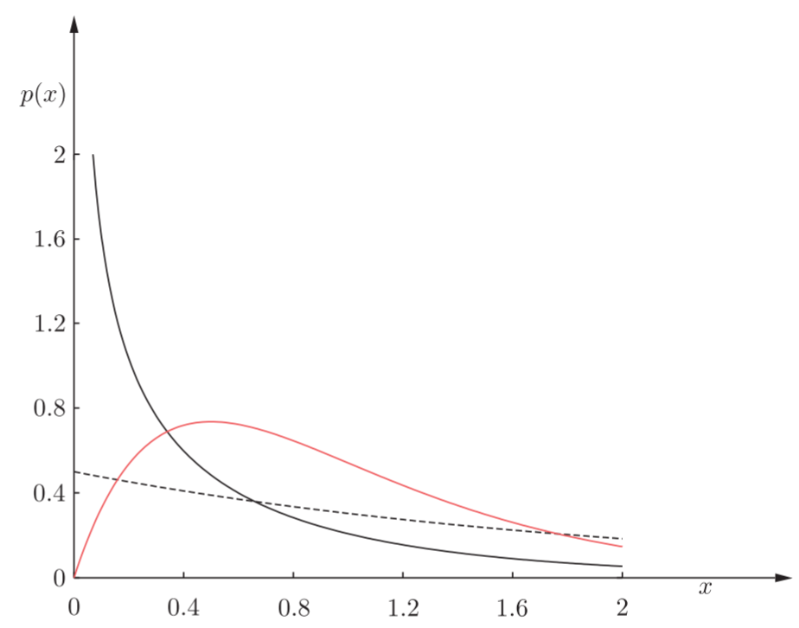
The gamma distribution (2)
The figure below shows the resulting graphs for various values of the parameters.

Slide 22
Case Study
Given data of Singapore Airbnb which can be downloaded in this link
https://www.kaggle.com/jojoker/singapore-airbnb
You have identified the discrete and continuous random variables in the previous section. Now, you can also identify the distribution for both discrete and continuous variables.
Try in Google Collaboratory:
Plot the data on a histogram
Find a well known distribution
Generate and plot the pdf on top of your histogram

Slide 23
End of Session 07 & 08

Slide 24
References
Sergios Theodoridis. (2015). Machine Learning: a Bayesian and Optimization Perspective. Jonathan Simpson. ISBN: 978-0-12-801522-3. Chapter 2.
https://www.kaggle.com/jojoker/singapore-airbnb

